Slide 1
Applied Data Science Project- SpaceX Falcon 9 launch
Author:-Divya Krishnakumar
Date:-11/04/2025

Slide 2
Table of Contents
SL No. | Title | Slide Number
1 | Executive Summary | 3
2 | Introduction | 4
3 | Methodology | 5
4 | Result | 6-22
5 | Discussion Findings and Implications | 23-24
6 | Conclusion | 25

Slide 3
Executive Summary
SpaceX advertises Falcon 9 launches with a cost of 69 million dollars with a view to reuse the first stage thereby saving much of the cost. If probability of success of first time launch is determined then the cost of launch can be determined. The aim of this project is to predict whether Falcon 9 first stage will launch successfully.
The dataset for this project is collected from "https://api.spacexdata.com/v4/launches/past" and filtered the data to include only Falcon 9 launches during data collection phase. There are different cases in the dataset where the booster landing was successful and unsuccessful. These cases are True Ocean, where booster was successfully landed in the ocean; False Ocean, where the landing mission outcome unsuccessfully landed to a specific region of the ocean; True RTLS, the mission outcome was successfully landed to a ground pad False RTLS means the mission outcome was unsuccessfully landed to a ground pad; True ASDS, means the mission outcome was successfully landed on a drone ship; False ASDS, means the mission outcome was unsuccessfully landed on a drone ship. Exploratory Data Analysis was performed in which missing values are replaced with mean of the given values. The landing outcome for each launch is determined. The data set was subjected to SQL queries for better understanding of the data. From this, the success rate of landing outcome was found to be 67%. The landing outcomes are converted into training labels.
Each launch aims to a dedicated orbit such as Low Earth Orbit(LEO), Very Low Earth Orbit(VLEO), Geosynchronous Orbit(GTO), Sun Synchronous Orbit(SSO), ELS-1, Highly Elliptical Orbit(HEO), ISS, MEO(Intermediate Circular Orbit), HEO (Geo Centric Orbits), GEO(Circular Geosynchronous Orbit), PO(Polar). The launch success rate may depend on many factors such as payload mass, orbit type etc. Data visualisation is performed to find success rate of each orbit type. The success rate may also depend on location and proximities of a launch site i.e. the initial position of rocket trajectories. Finding an optimal location for building a launch site certainly involves many factors. The success/failed launches for each site is marked on the map. A Dash application is created to visualize the success rates of each site. Then machine learning is implemented to predict the success rate of the launches. The accuracy score is determined to identify how much the predicted value deviates from the actual values.

Slide 4
Introduction
This project is for SpaceX which bids for 69 million dollars for a project in which first launch can be reused. The aim of this project is to predict the probability of success of first launch.
The key questions are:
What is the success rate of first launch?
What are the success rates of each Launch Site?
Which Booster Version has highest launch success rate?
Which orbits have more positive landing rate for different payloads?

Slide 5
Methodology
The dataset for this project is collected from api.spacex.com.
The methodology includes the following steps such as Data Collection; Exploratory Data Analysis-Data Wrangling, Data Visualisation; Data Modelling
The collected data is cleaned, analysed, generated labels for classification. The data is subjected to classification algorithms such as Logistic Regression, Support Vector Machine, Decision Tree Classifier, KNearestNeighbors.

Slide 6
Result
Data Collection
The data is collected from https://api.spacexdata.com/v4/launches/past using a request- response API and converted into JSON format and then to a pandas dataframe. The columns of the dataframe are FlightNumber, Date, BoosterVersion, PayloadMass, Orbit, LaunchSite, Outcome, Flights, GridFins, Reused, Legs, LandingPad, Block, ReusedCount, Serial, Longitude, Latitude. Then the dataframe is filtered to obtain only Falcon 9 launches.
Data Analysis
As a part of analysis missing values are replaced with mean. Then the number of launches of each site is determined. The number and occurrence of mission outcomes is calculated. The different landing outcomes are determined. Finally landing outcome label is created for each landing outcome.

Slide 7
Result(Contd)
The dataframe thus formed is the following. Here only first 5 rows of the dataframe is displayed.
 | FlightNumber | Date | BoosterVersion | PayloadMass | Orbit | LaunchSite | Outcome | Flights | GridFins | Reused | Legs | LandingPad | Block | ReusedCount | Serial | Longitude | Latitude | Class
0 | 1 | 04-06-2010 | Falcon 9 | 6104.95941 | LEO | CCAFS SLC 40 | None None | 1 | FALSE | FALSE | FALSE | NaN | 1 | 0 | B0003 | -80.577366 | 28.561857 | 0
1 | 2 | 22-05-2012 | Falcon 9 | 525 | LEO | CCAFS SLC 40 | None None | 1 | FALSE | FALSE | FALSE | NaN | 1 | 0 | B0005 | -80.577366 | 28.561857 | 0
2 | 3 | 01-03-2013 | Falcon 9 | 677 | ISS | CCAFS SLC 40 | None None | 1 | FALSE | FALSE | FALSE | NaN | 1 | 0 | B0007 | -80.577366 | 28.561857 | 0
3 | 4 | 29-09-2013 | Falcon 9 | 500 | PO | VAFB SLC 4E | False Ocean | 1 | FALSE | FALSE | FALSE | NaN | 1 | 0 | B1003 | -120.610829 | 34.632093 | 0
4 | 5 | 03-12-2013 | Falcon 9 | 3170 | GTO | CCAFS SLC 40 | None None | 1 | FALSE | FALSE | FALSE | NaN | 1 | 0 | B1004 | -80.577366 | 28.561857 | 0

Slide 8
Result(Contd)
Then SQL queries are performed on the dataset for better understanding of the dataset.
In this total payload mass carried by boosters launched by NASA (CRS) is determined to be 45596kg. The average payload mass of booster version F9 v1.1 is determined as 2535kg. The total number of successful and failure mission outcomes is determined as in the following table.
Mission Outcome | Number of outcomes
Failure (in flight) | 1
Success | 98
Success | 1
Success (payload status unclear) | 1

Slide 9
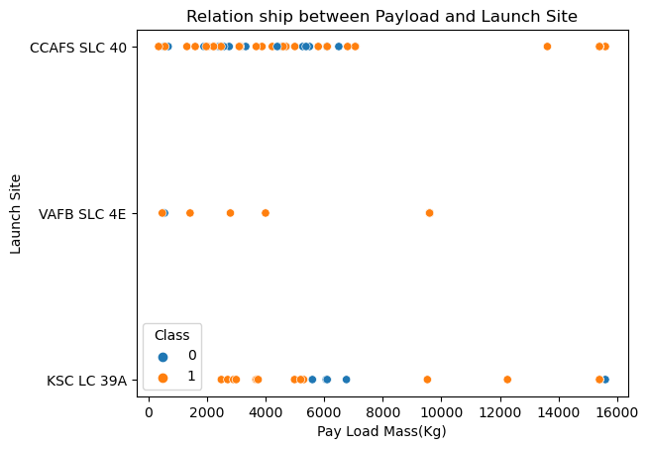
Result(Contd)
Data Visualisation
A scatter plot is drawn to show relationship between payload and launch site.

Slide 10
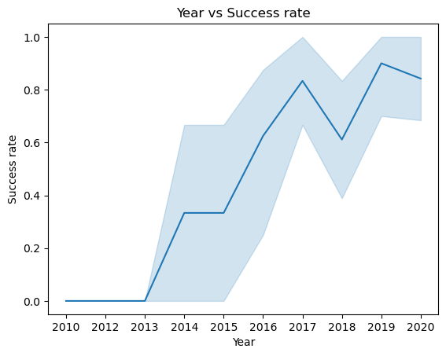
Result(Contd)
The success rate since 2013 kept increasing till 2017 (stable in 2014) and after 2015 it started increasing. Visualised the launch success yearly trend.

Slide 11
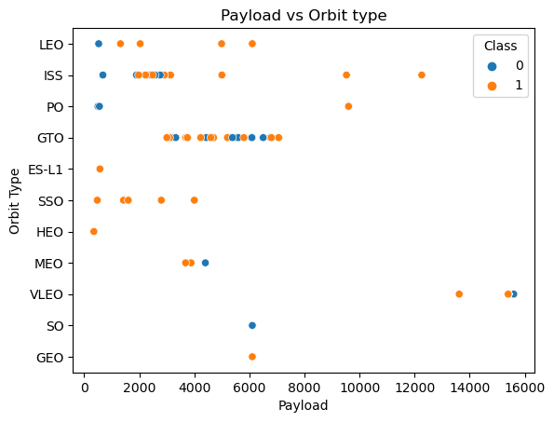
Result(Contd)
With heavy payloads the successful landing or positive landing rate are more for Polar, LEO and ISS. However, for GTO we cannot distinguish this well as both positive landing rate and negative landing(unsuccessful mission) are both there here.

Slide 12
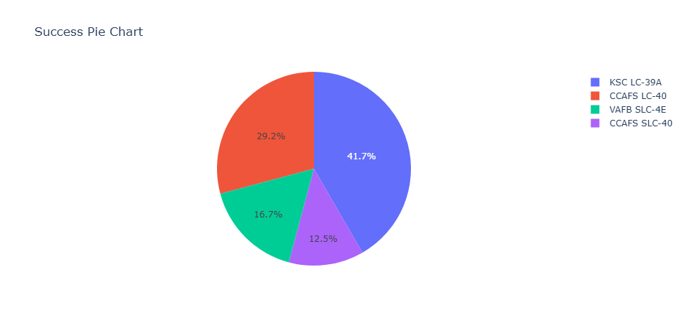
Result(Contd)
A Dash application was developed to visualize the success rates of each site The pie chart for all success of all launch sites is shown below
.

Slide 13
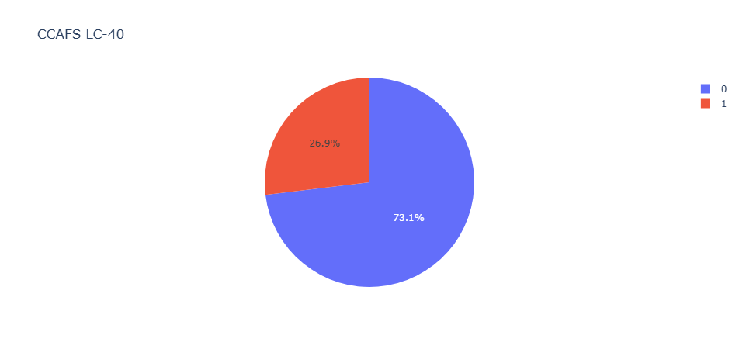
Result(Contd)
The pie chart for success launch of site CCAFS LC-40

Slide 14
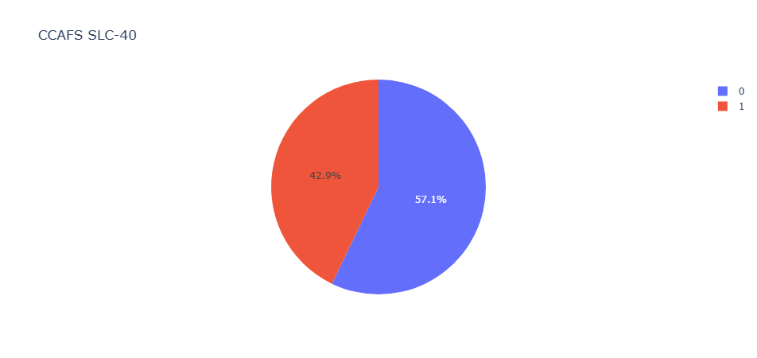
Result(Contd)
The pie chart for success launch of site CCAFS SLC-40

Slide 15
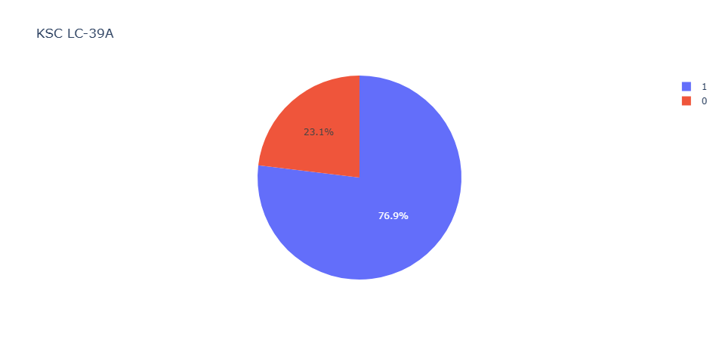
Result(Contd)
The pie chart for success launch of site KSC-LC 39A

Slide 16
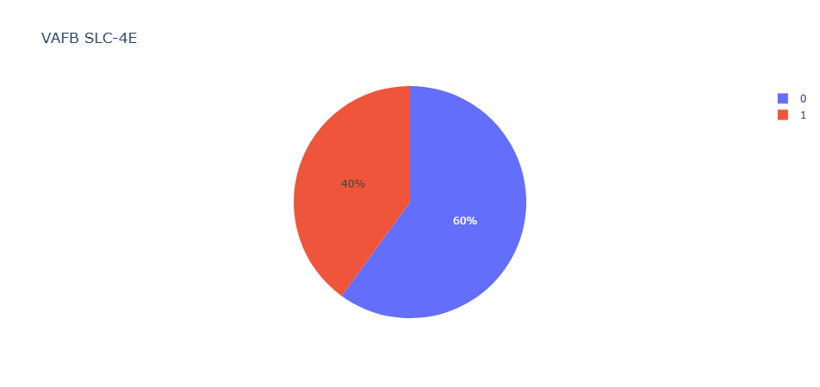
Result(Contd)
The pie chart for success launch of site VAFB SLC-4E

Slide 17
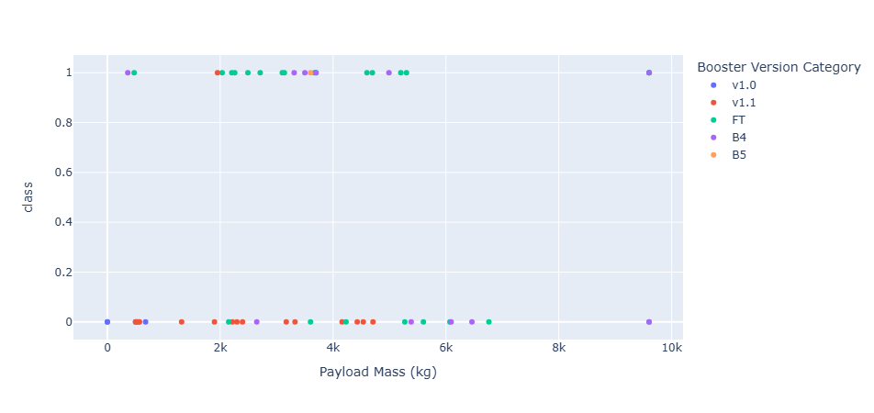
Result(Contd)
The scatter plot for all launch sites

Slide 18
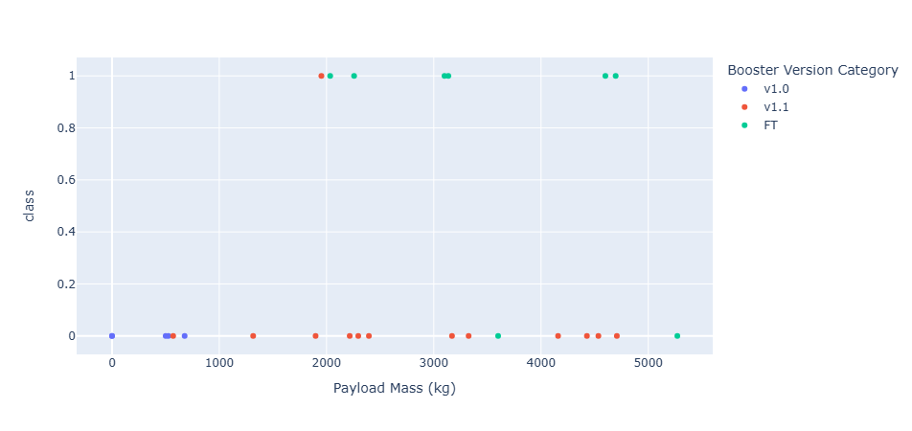
Result(Contd)
The scatter chart for success launch of site CCAFS LC-40

Slide 19
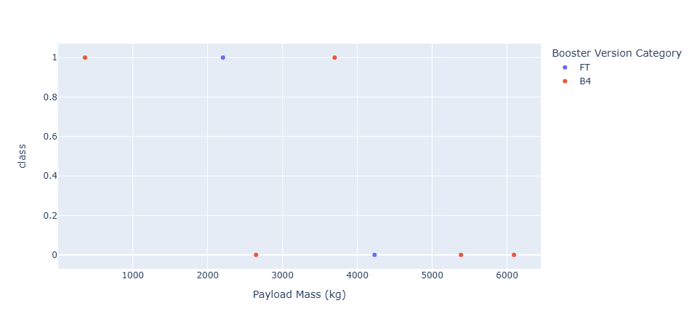
Result(Contd)
The scatter chart for success launch of site CCAFS SLC-40

Slide 20
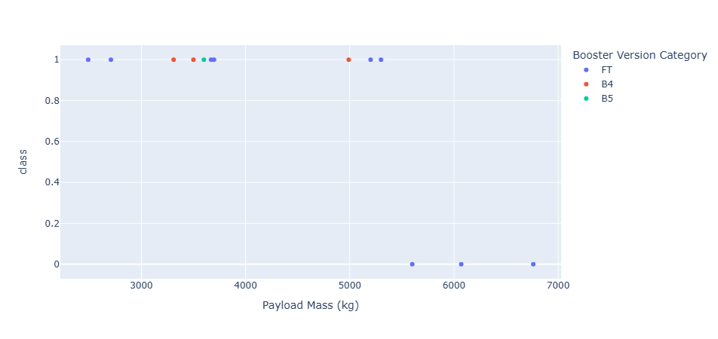
Result(Contd)
The scatter chart for success launch of site KSC LC-39A

Slide 21
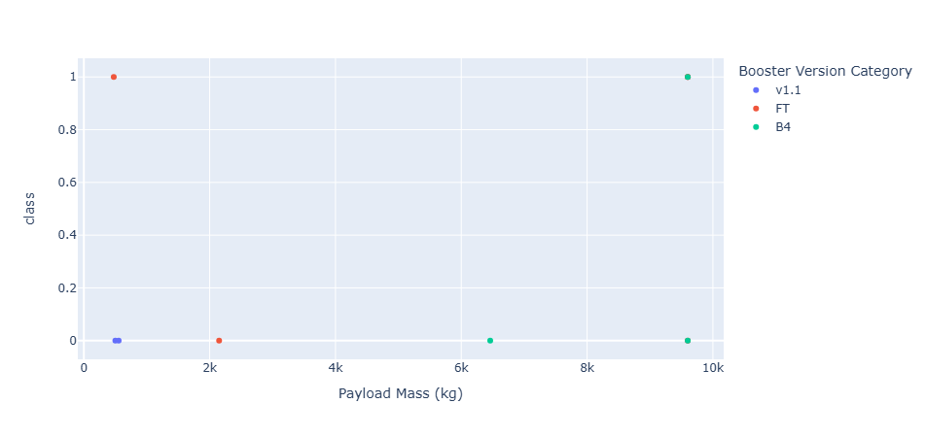
Result(Contd)
The scatter chart for success launch of site VAFB SLC-4E

Slide 22
Result(Contd)
Data Modelling
The data set is subjected to machine learning pipeline after feature engineering. The machine learning models of Logistic Regression, Support Vector Machine and Decision Tree Classifier and KNearestNeighbors are created and fitted on the training data. The results are predicted for each model.

Slide 23
Discussion Findings and Implications
The success rates of launch site KSC LC-39 A is 47.1%.
The success rate of launch site CCAFS LC-40 is 29.2%.
The success rate of launch site VAFB SLC-4E is 16.7%.
The success rate of launch site CCAFS SLC-40 is 12.5%.
From this it is evident that KSC LC-39A has highest success rate and CCAFS SLC-40 has least success rate.
The successful launches of KSC LC-39A when compared to unsuccessful launches is 76.9%.
FT booster version has highest launch success rate followed by B4.

Slide 24
Discussion Findings and Implications
The success rates are high for payload of 2000 to 6000.
The logistic regression, Support Vector machine and KNearestNeighbors showed an accuracy score of 83% on the test data.
The decision tree showed an accuracy score of 87% on test data.
This means that the probability of successful first launch is 83% to 87%.

Slide 25
Conclusion
The total number of success outcomes is found to be high. The success rate is increasing since 2015. With heavy payloads the successful landing or positive landing rate are more for Polar, LEO and ISS. The success rate of KSC LC-39A is the highest. FT booster version has the highest success launch rate.
From the above findings the probability of successful launch is very high. All the unsuccessful launches are preplanned. Thus, we can conclude that first launch will be successful.

Slide 26
Acknowledgement
I here by acknowledge my sincere gratitude towards the entire IBM Skills Network team and Course era to complete my project successfully in due time. I thank every one who provided all resources in completion of this project. I thank the authors of the project especially Prof. Joseph Santarcangelo to provide guidance and resources for the project.

Slide 27
Appendix and References
https://api.spacexdata.com/v4/launches/past
Reading: Structure Of A Report | Coursera
Data Collection Overview | Coursera
Applied Data Science Capstone-IBM

